Slide 1


The Road To Ethical Hacking
(6) Technical: Introducing Everything NMAP
November 1, 2018

Slide 2

WARNING
Before network scanning make sure you have explicitly written permission. Or else contact your local laywer.
!!!!!
Tell your kids, friends, family and mistress that you may not be around.

Slide 3
Vocabulary & Acronyms
DNS : Domain Name System
PING : Packet InterNet Groper
IP : Internet Protocol
LAN : Local Area Network
MAC: Media Access Control

Slide 4
No ping
Dead or Alive
Hiding systems
Makes the jobs of attackers harder but not impossible
A little more work
What is ping? (ICMP echo request)
Tests whether the host is up. By sending a request.
Disadvantages: A host may not send back the request.
Normal scans will not properly scan hosts.
By default (Reverse DNS resolution [lookup]) * IP →Domain , is enabled
use –n flag. to disable rDNS.

Slide 5
Dead or Alive
Regular Scan
nmap 18.213.119.84
Defaults: ping sweep →rDNS → Scan ports
DNS stand for Domain Name System
nmap –n 18.213.119.84 (disable reverse DNS lookup)
-n flag: ping sweep → Scan ports
Ports open 22/tcp, 80/tcp, 443/tcp (What is the server)

Slide 6
Dead or Alive
Flag: (Assuming host allow ping request)
-sn (ping sweep)
Ex: nmap –sn 18.213.119.84
ping sweep → rDNS , no port scan
nmap –sn -n 18.213.119.84 (faster)
ping sweep → no rDNS , no port scan
Supposed to give you “0 host up”
Flag: (host does not allow ping request)
-Pn (no ping)
Will also scan host that may not be up.
Example No Flag: nmap -n 18.213.119.84
( ping sweep) → no rDNS → Scanning ports *those that respond
Example with Flag: nmap –pn –n 18.213.119.84
no ping sweep → nor rDNS → Scanning ports *No response

Slide 7
-sL flag List Scan
-sL is useful for DNS look up
nmap 18.213.123.154-159 –sL
recall 154-159 is the range. That is 18.213.123.154, 18.213.123.155.. 18.213.123.159
We scanned 6 IP addresses and 0 host are up.
This means two things.
Hosts do not accept ICMP echo request (ping)
Host do not exist or are not up
Result: compute-1.amazonaws
What does this mean? What is amazon aws

Slide 8
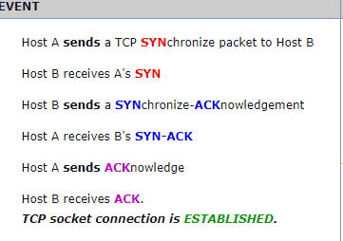
ICMP ping request | TCP SYN ping scan
Administrators may disable ICMP ping request
This makes host seem as if they are down and will not be scanned
TCP SYN ping scan
Recall the three way handshake
We send a SYN request to a specific port, if it responds we assume it is online.
FLAG: -PS
Example: -PS 22 (-P is ping, S is the method, combine them)
Recall 22 is the default port for Secure Shell (SSH)
https://www.inetdaemon.com/tutorials/internet/tcp/3-way_handshake.shtml

Slide 9
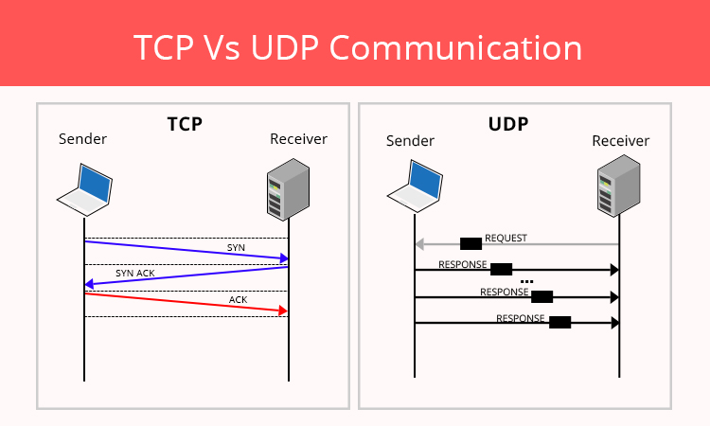
UDP (User Datagram Protocol)
UDP is difficult to scan.
It is connectionless communication
It sends packets without determining if the receiver exists.
No handshaking.
It does not care if (UDP packets) data is received.
Reduces latency (It is fast)
Always do TCP scans before UDP scans. UDP scans are very slow.
You will be waiting for a while.
Who uses UDP?
Who needs convenience but not quality?
https://www.oodlestechnologies.com/blogs/Why-UDP-is-preferred-for-Live-Streaming

Slide 10
-sU flag (Scanning User Datagram Protocol)
Example:
sudo nmap –sU ocf.berkeley.edu –p123
We should by now know what sudo is.
running nmap with elevated privileges –sU is states we want to scan UDP ports
ocf.berkeley.edu is the name of our host
NOTE: rDNS is enabled. use –n to disable. (optional)
-p123 tells nmap we want to scan port 123
Results:
ntp service (Network Time Protocol).
It’s default port is 123, and is generally under UDP.
Open|Filtered means it may or may not be allow public to connect.

Slide 11
How to not get caught
IDS (Intrusion Detection Systems)
Can detect scans (SYN scans)
Using the following flags *Types of scans
The following will issue a (RST) packet, that is reset the connection.
FIN (Spanish for “END”) (“Stop talking, just listen”)
FLAG: -sF
Example: sudo nmap –sF –n ocf.berkeley.edu –p80 --reason
-p80 (port 80, recall this is http by default)
--reason (states the method used to determine the state of the port)
RESULT: reset ttl 255 (ttl = time to live)
Xmas Tress (May not be covered)
FLAG: -sX
https://nmap.org/book/man-port-scanning-techniques.html
Null
“Can Sneak through non-stateful firewalls and packet filtering routers. “
Some IDS can detect them.
Can not distinguish between open|filtered

Slide 12

Operating System *Flag: -O
What is an Operating System?
“the software that supports a computer's basic functions, such as scheduling tasks, executing applications, and controlling peripherals.”
We must identify our target.
If we are scanning in the local lan, we can see the MAC address.
media access control
What is fingerprinting?
The size of your screen can be used to fingerprint.
We want to know who created the device, what software can it run.
An attackers sends a windows malicious software to a macOS user or Linux user?
Example: nmap -O -n scanme.nmap.org
Dectect the operating system, disable reverse DNS look up.
Example: sudo nmap -n -Pn -O 18.213.119.84

Slide 13
Changing your MAC Address
Follow this instructions
https://www.howtogeek.com/192173/how-and-why-to-change-your-mac-address-on-windows-linux-and-mac/

Slide 14
Packet Tracing (Flag: --packet-trace)
Similar to traceroute
The hops it takes to reach the target host.
Recall that in order to reach your target host, the packets sent must travel through different hosts.
If one of the intermediate host is down you will never reach your destination.
This is a debugging tool (Find where there is an error)
Packets may travel all over the nation or world before reaching the target.
You can measure the delay.
Delay may tell you how far a host is, or how fast a connection is.

Slide 15




Thank You
Ramiro Gonzalez
rgonzalez69@ucmerce.edu
ramirogonzalez.org
209-962-2524

